Slide 1


Architectures
Shipboard Power System Fundamentals
Revision of 29 December 2025
Dr. Norbert Doerry
http://doerry.org/norbert/MarineElectricalPowerSystems/index.htm
© 2025 by Norbert Doerry
This work is licensed via: CC BY 4.0 (https://creativecommons.org/)

Slide 2
Essential Questions
What is an architecture and what are the architectural modules (building blocks) of ship’s electrical and propulsion architectures? | Understand
What are implications of a radial architecture, zonal architecture, and ring bus architecture? | Understand
What are implications of a mechanical drive ship design, a hybrid drive ship design, and an integrated electric drive ship design? | Understand
What are implications of current type (a.c. and d.c.) and voltage level (low voltage and medium voltage) buses? | Understand

Slide 3
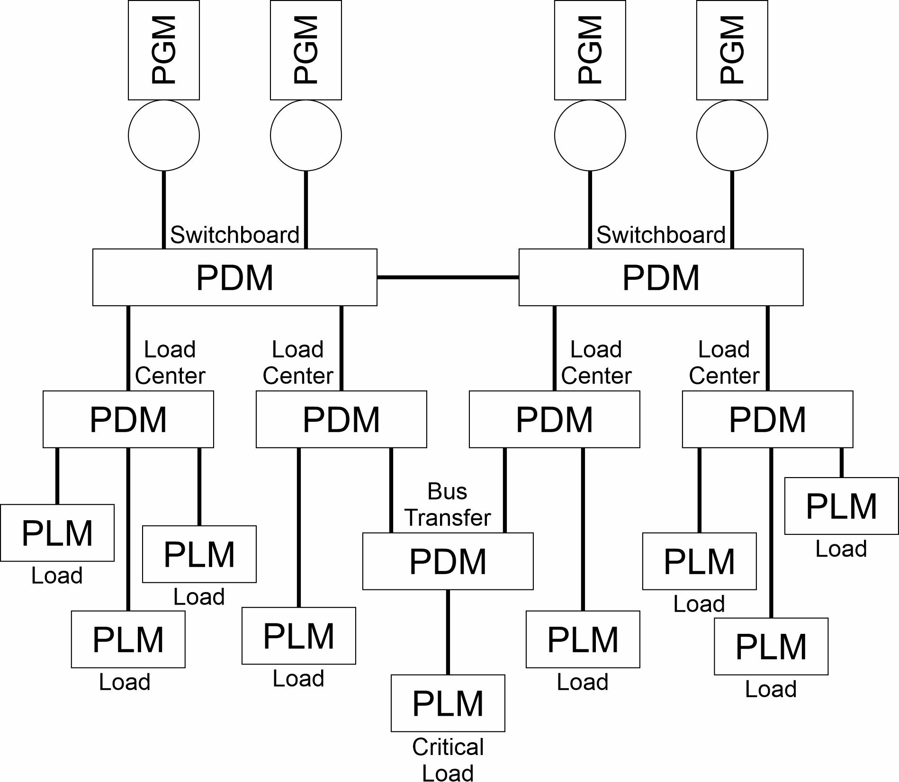
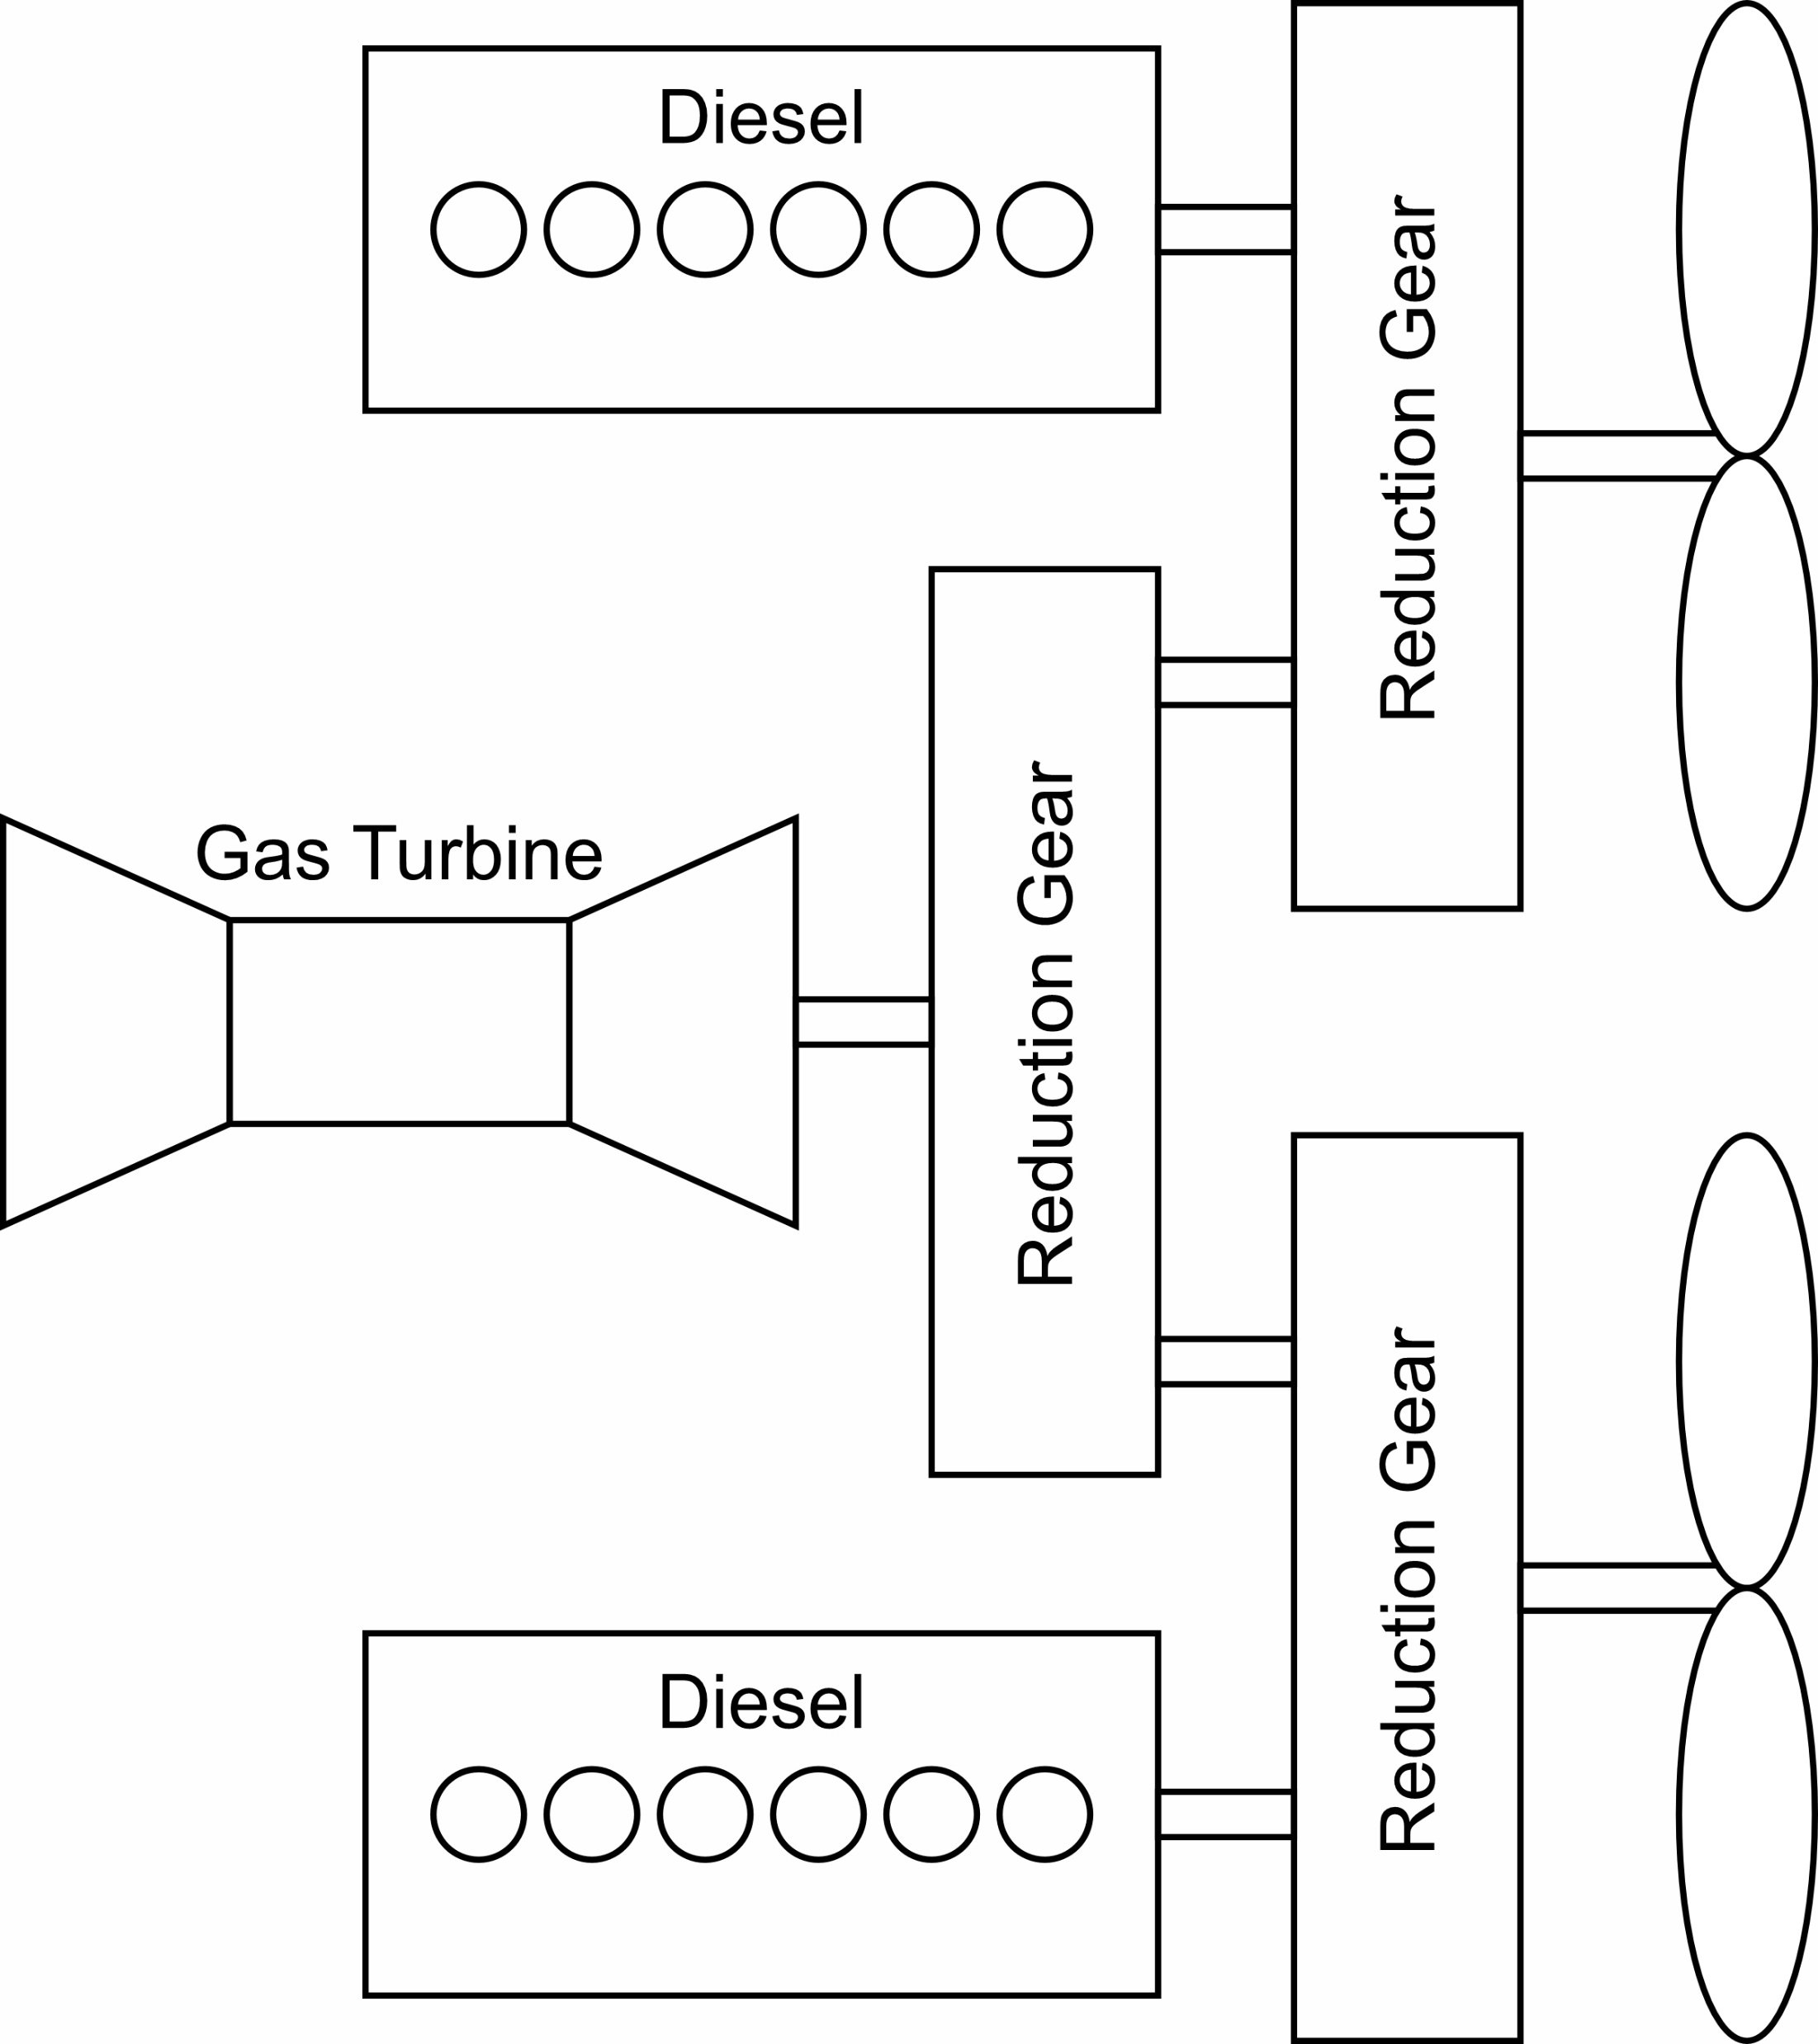
Architecture
Defines patterns for how elements of a system can connect and interact

Slide 4
Electrical power system architectural modules
Power Generation Module (PGM)
  Converts fuel (or other source of energy) into electrical power.
  Provides power to the PDM.
Power Distribution Module (PDM)
  Provides power connectivity between other modules.
Power Conversion Module (PCM)
  Converts electrical power of one type (interface standard) to another type.
Energy Storage Module (ESM)
  Stores electrical energy (charges electrically and discharges electrically).
Platform Load Module (PLM)
  User loads (can be called hotel loads or ship service loads).
Propulsion Motor Module (PMM)
  Converts electrical power into mechanical power for propelling the ship.
Power Control Module (PCON)
  Software (and possibly hardware) needed to successfully operate and maintain the electrical power system.

Slide 5
Voltage levels
Low, medium and high voltage are not universally defined to specific voltage levels.
  Discipline specific definitions.
Low voltage
  Up to 1,000 volts (either ac or dc).
  Term “low voltage” may be defined differently depending on standard.
    For example, many safety standards define low voltage as below ~40 volts.
Medium voltage (or high voltage)
  1,000 volts (either ac or dc) to ~30,000 volts.
  Virtually all shipboard electrical power systems below 15,000 volts.
  Use of term “medium voltage” or “high voltage” inconsistent among standards.
1,000 may be considered either low voltage or medium (high) voltage depending on interface standard used.

Slide 6
Radial architecture
Sources are PGMs, outputs of PCM, and discharge interfaces of ESM.
All sources connect to a switchboard and all switchboards have at least one source connected to it.
All loads powered via one or more PDMs from a single switchboard.
  PDMs include load centers and power panels.
Switchboards are powered from attached sources or from other switchboards via bus-ties.
Critical loads use bus transfers to change connections from one switchboard to another.
Loads connected to each switchboard may be located anywhere in the ship.
If all switchboards are interconnected, then in parallel plant operation.
If the power system operates as two or more independent systems, then in split plant operation.
Bus-Tie
Example
Low voltage radial architecture

Slide 7
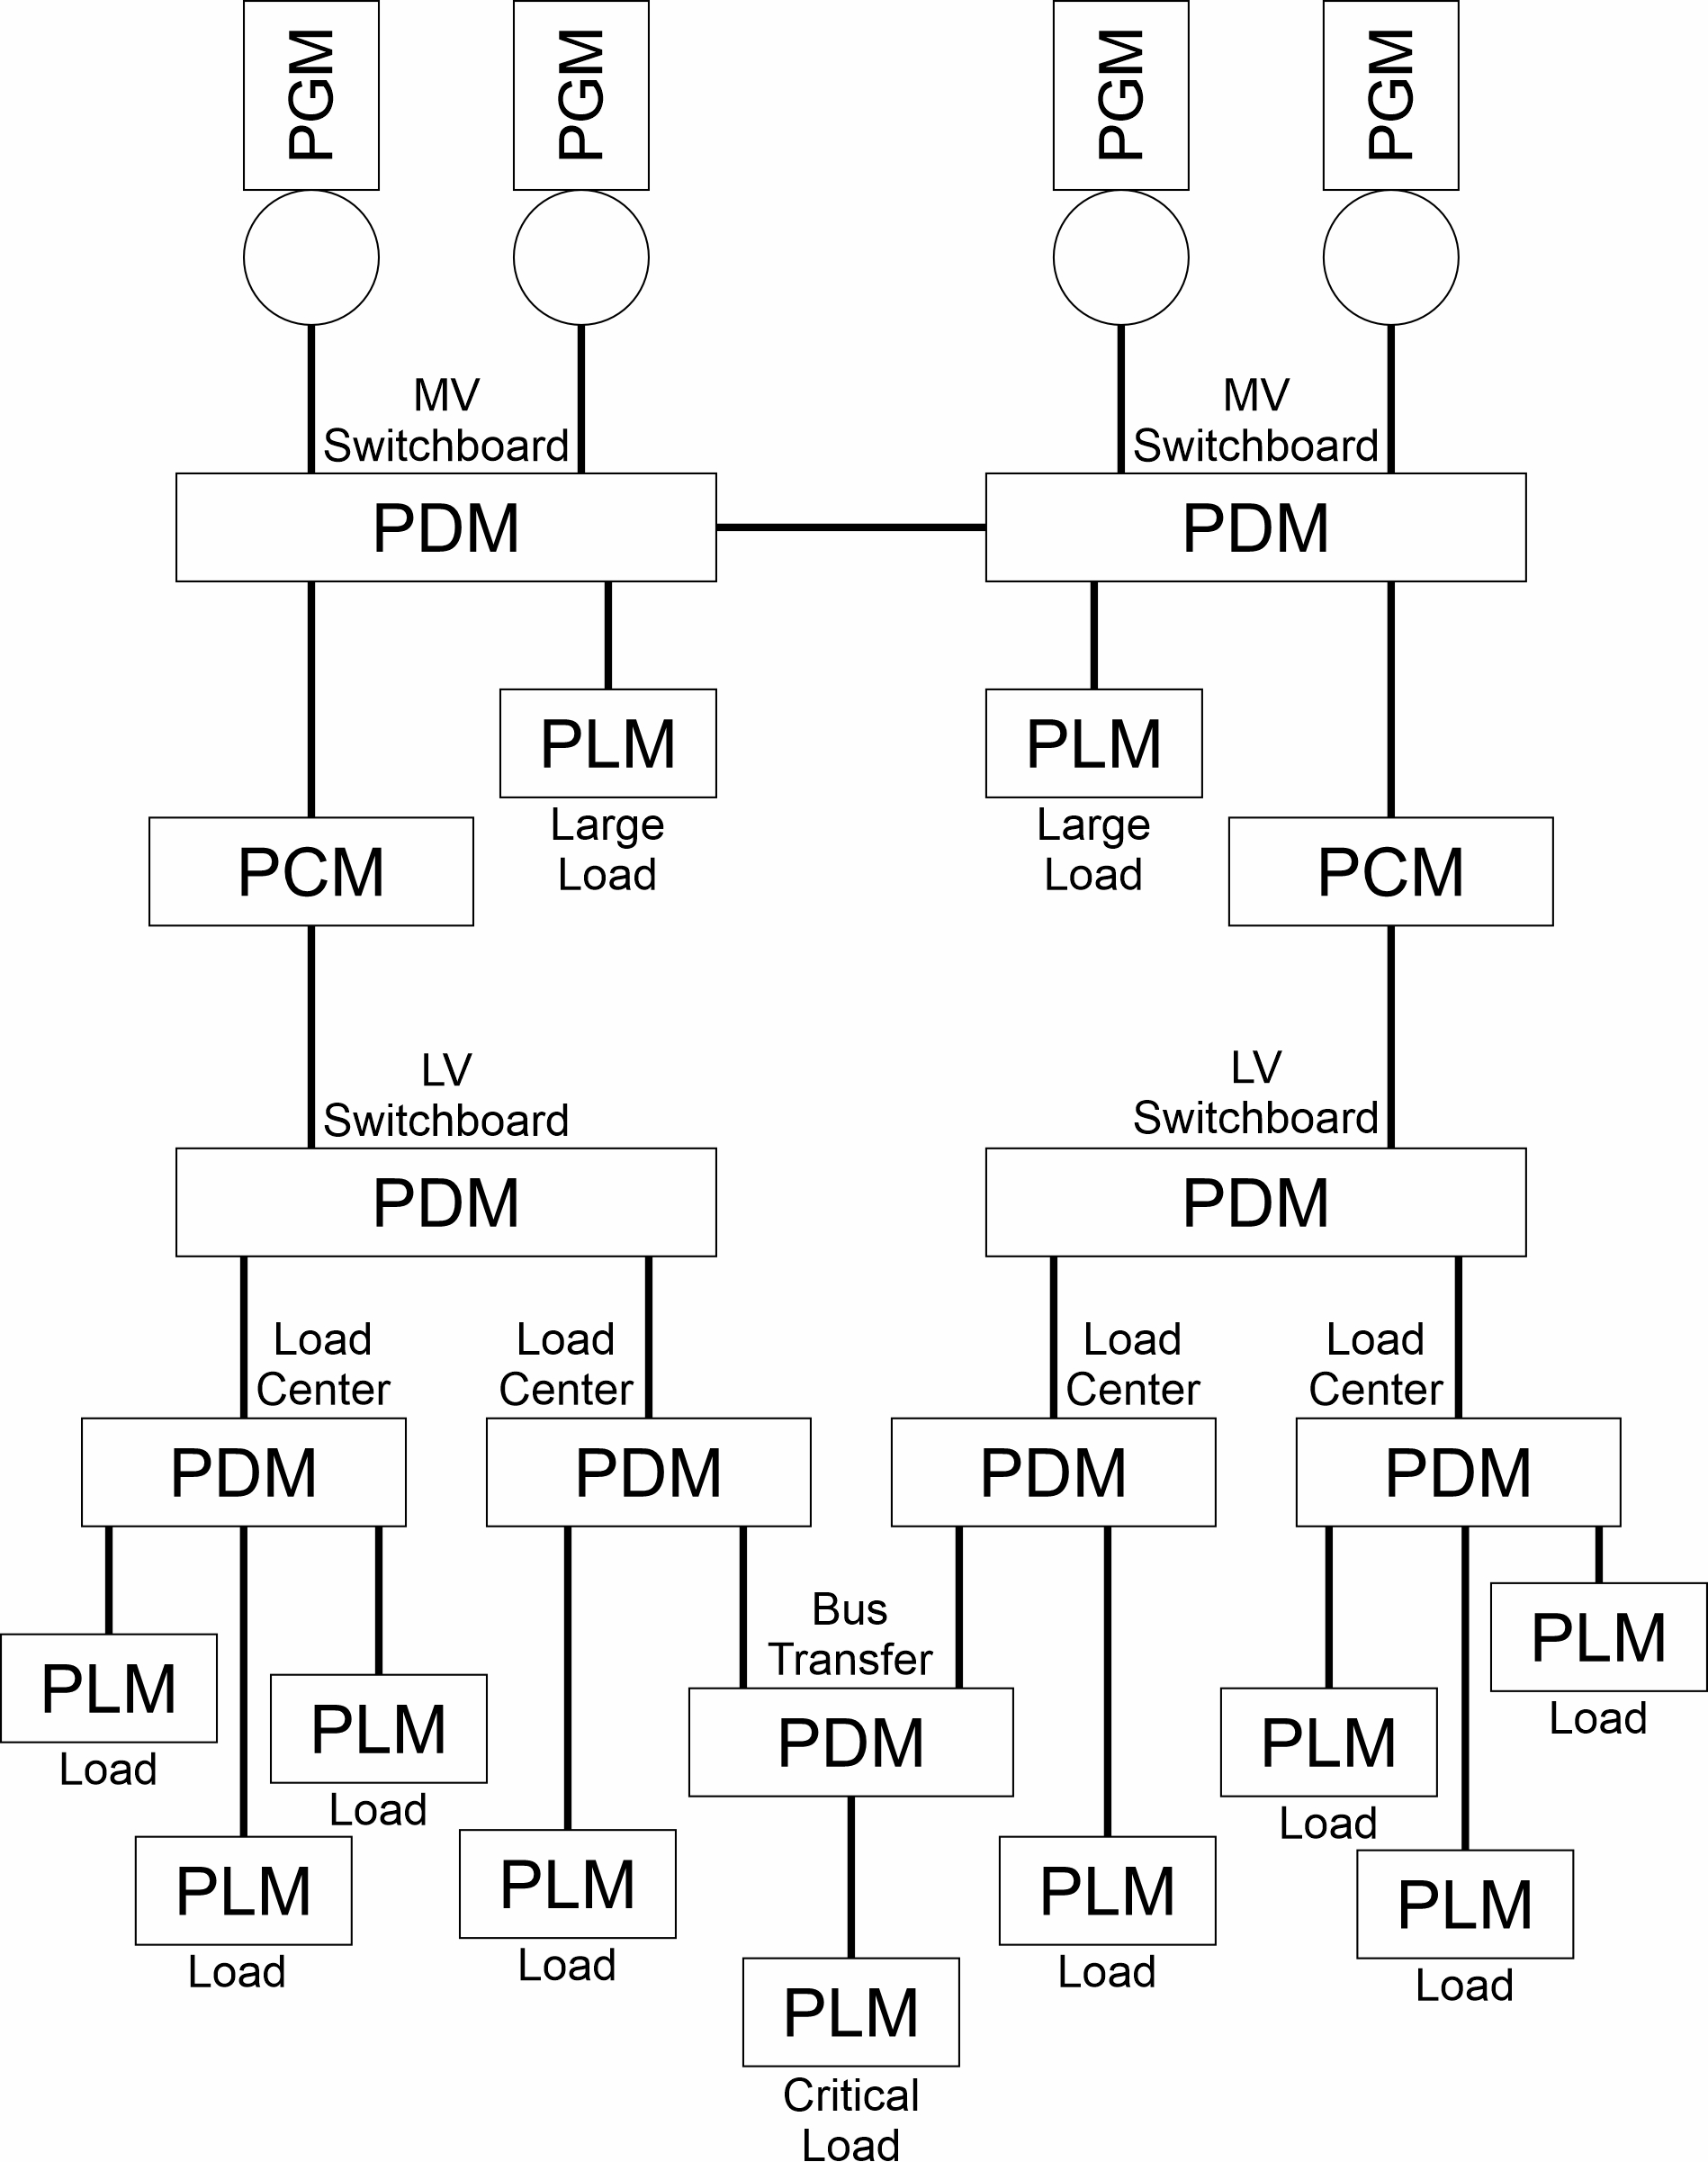
Medium voltage radial architecture
Bus-Tie

Slide 8
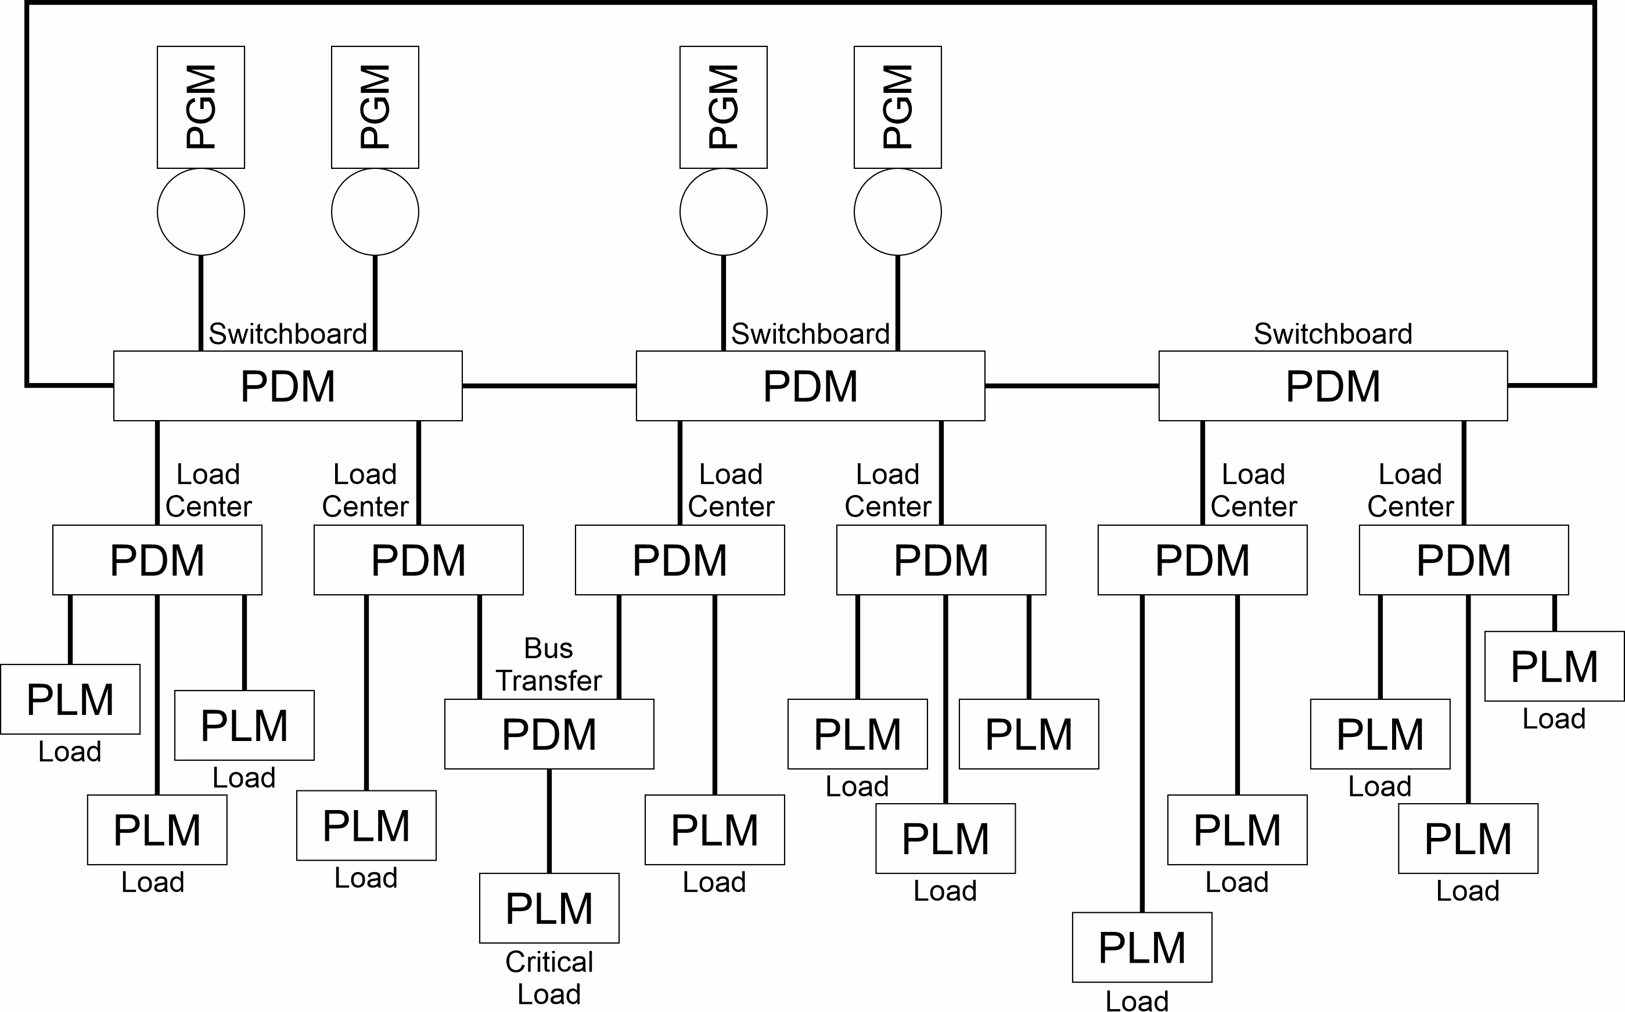
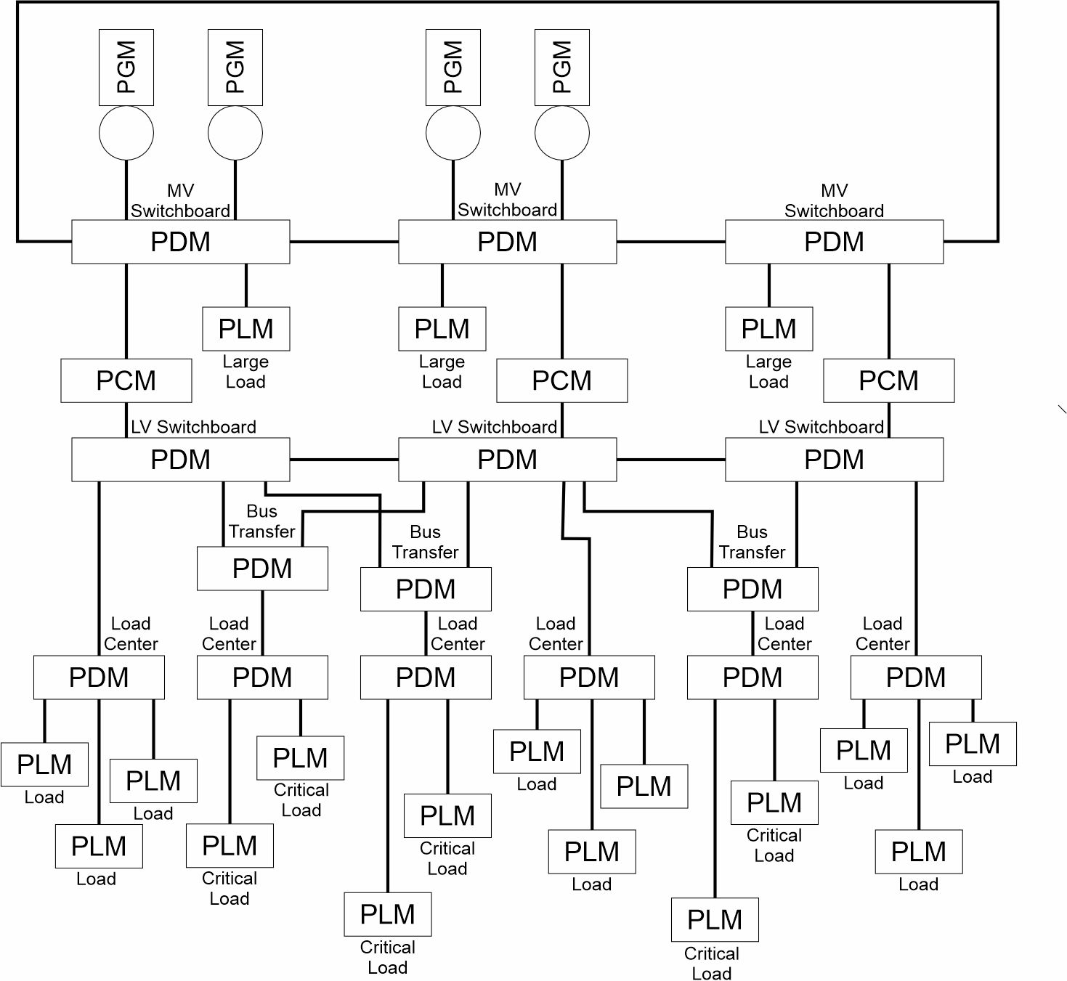
Ring bus
Similar to radial architecture with following exceptions:
  Not every switchboard requires an associated source
  Switchboards connected in a ring such that power continuity maintained with the loss of an arbitrary bus-tie

Slide 9
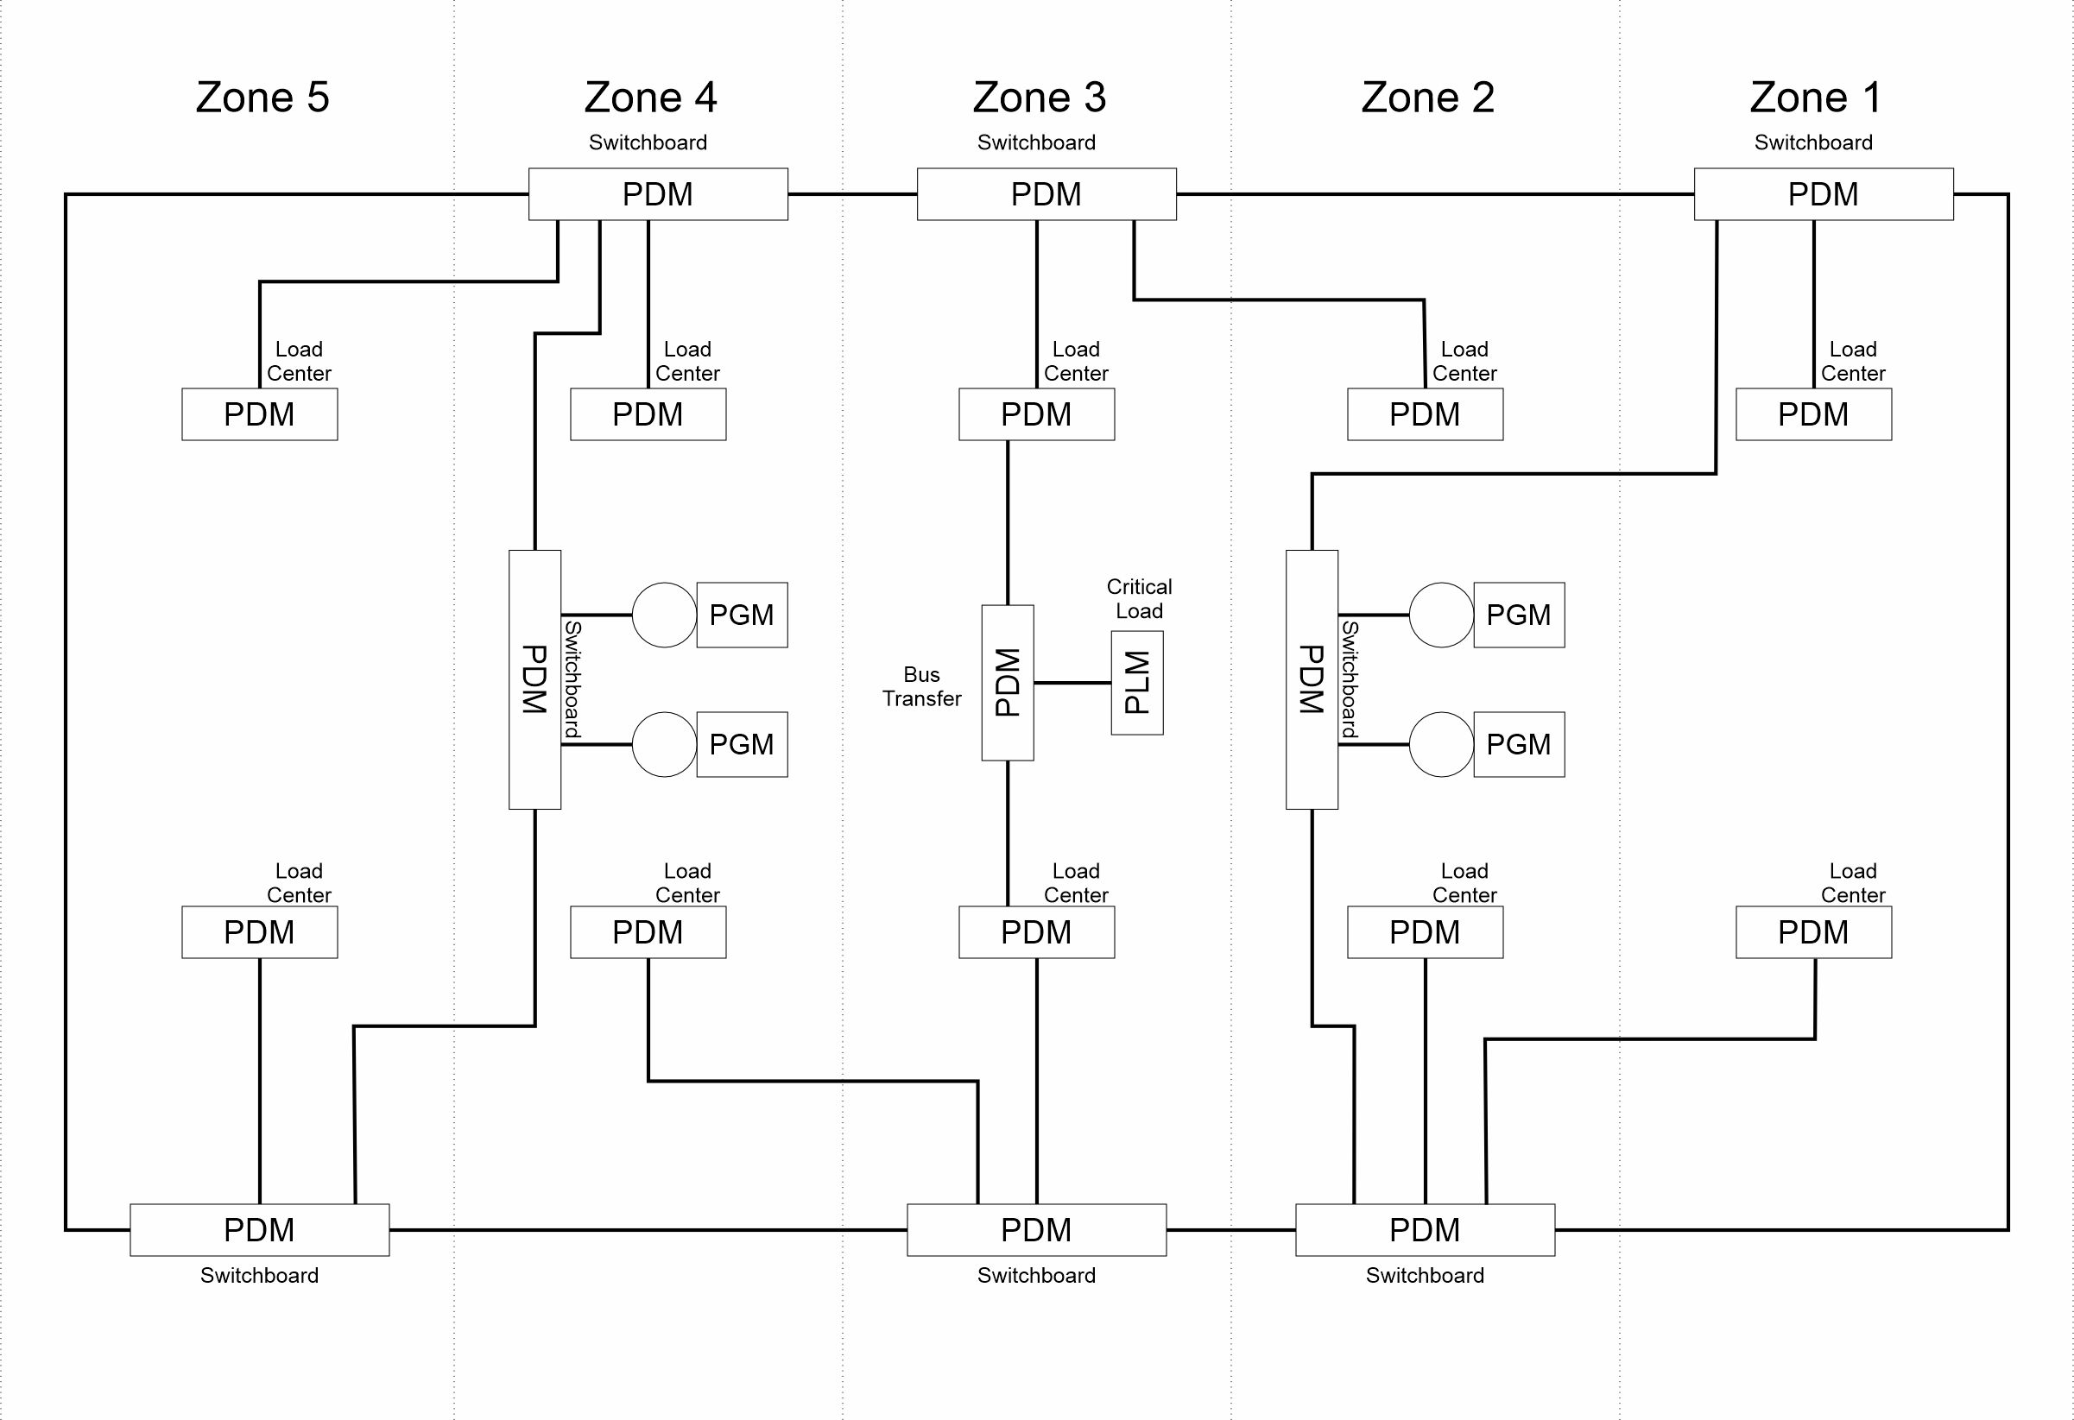
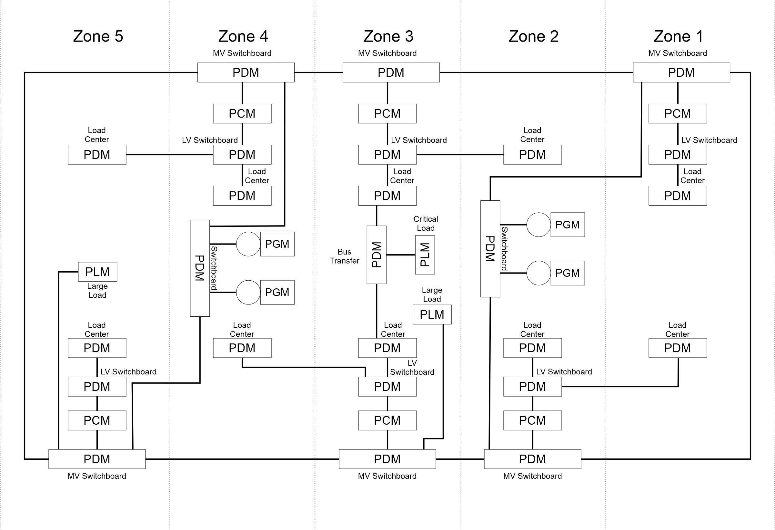
Zonal architecture
Similar to ring bus with the following exceptions
  Ship is divided geographically into multiple zones.
  Ring bus typically configured as port and starboard buses.
    Buses segmented by switchboards.
    Switchboards power load centers either directly or via PCM.
    Load centers may be powered by a switchboard in another zone.
  Ring bus may operate at medium voltage.
    PCM with associated LV switchboard provide power to loads
  Sources usually connect to generator switchboards that may connect to either bus.
  Port and starboard buses may be capable of being interconnected, but system normally operated in split plant.
  All loads powered by load centers or switchboards within the zone. Critical loads may connect to either bus via switchboards, load centers, and bus transfers.
  Designed to provide zonal survivability.

Slide 10
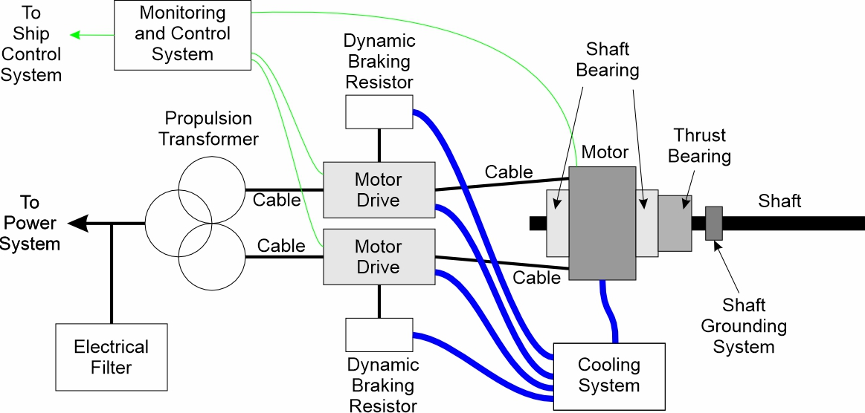
Propulsion system building blocks
Mechanical or Hybrid
  Prime mover
  Reduction gears
Electric Propulsion
  Propulsion motors
  Motor drive
  Propulsion transformer
  Electrical filters
  Dynamic braking resistors
Shafting
Line (shaft) and thrust bearings
Sern tubes
Struts
Propulsors
To
Stern tubes
Struts
Propulsors

Slide 11
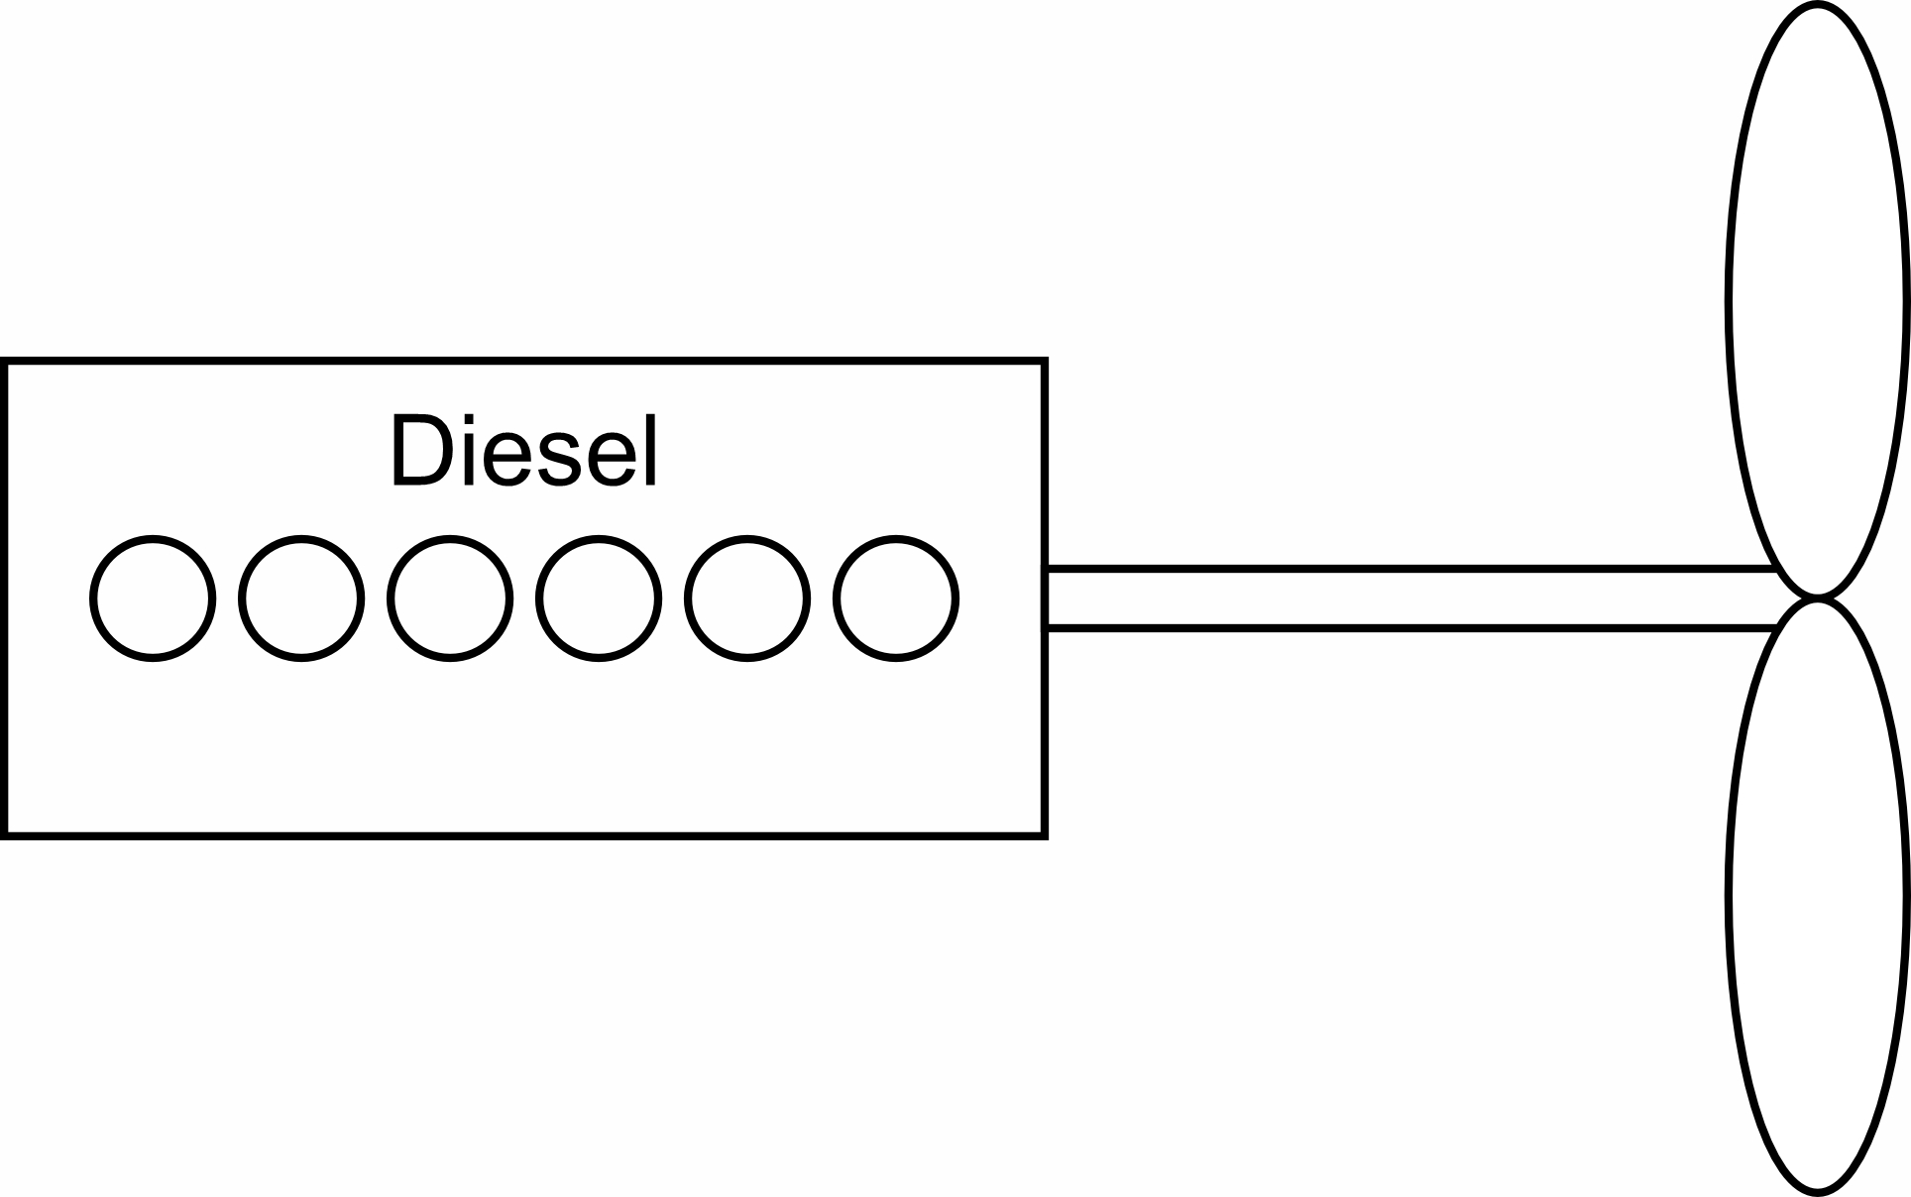
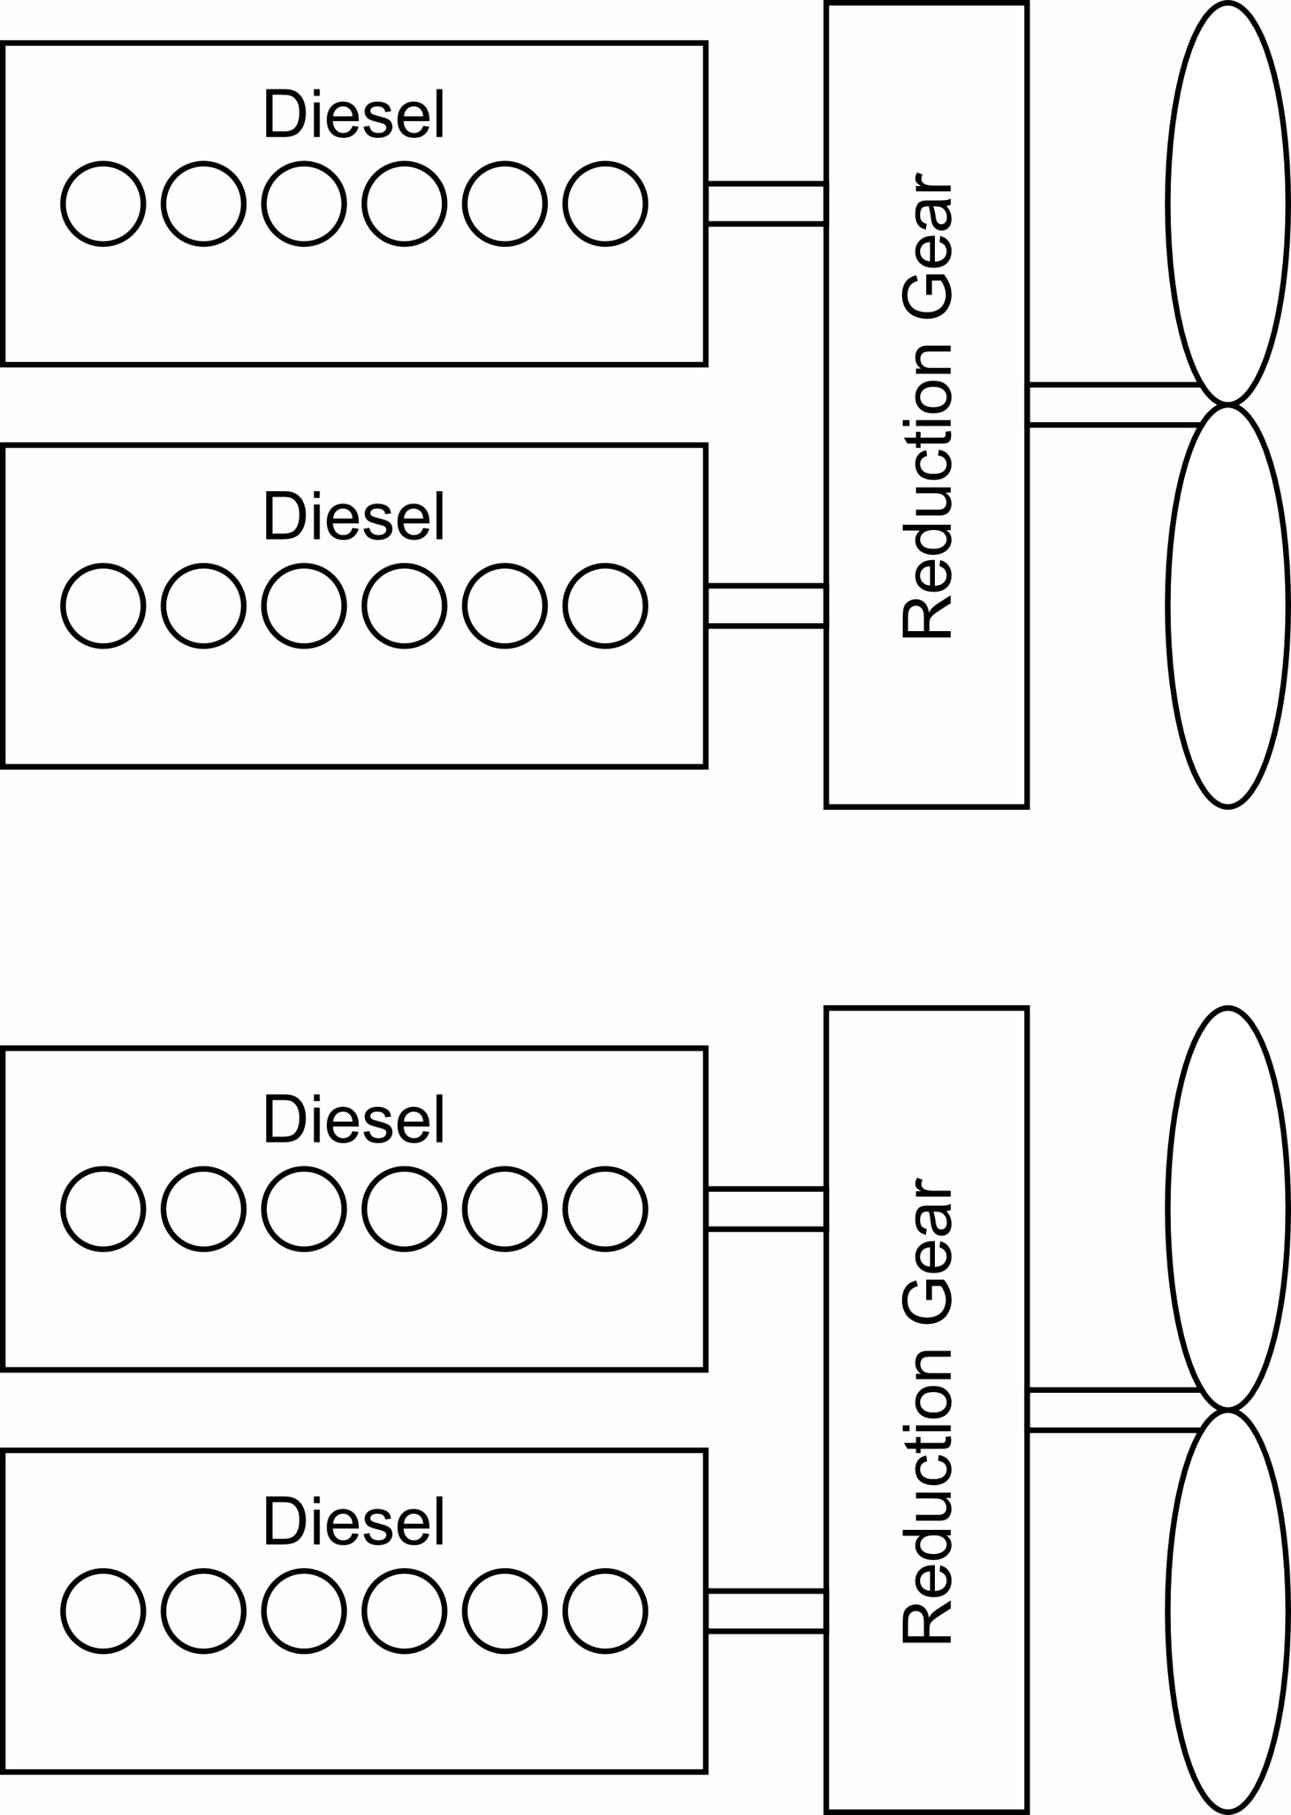
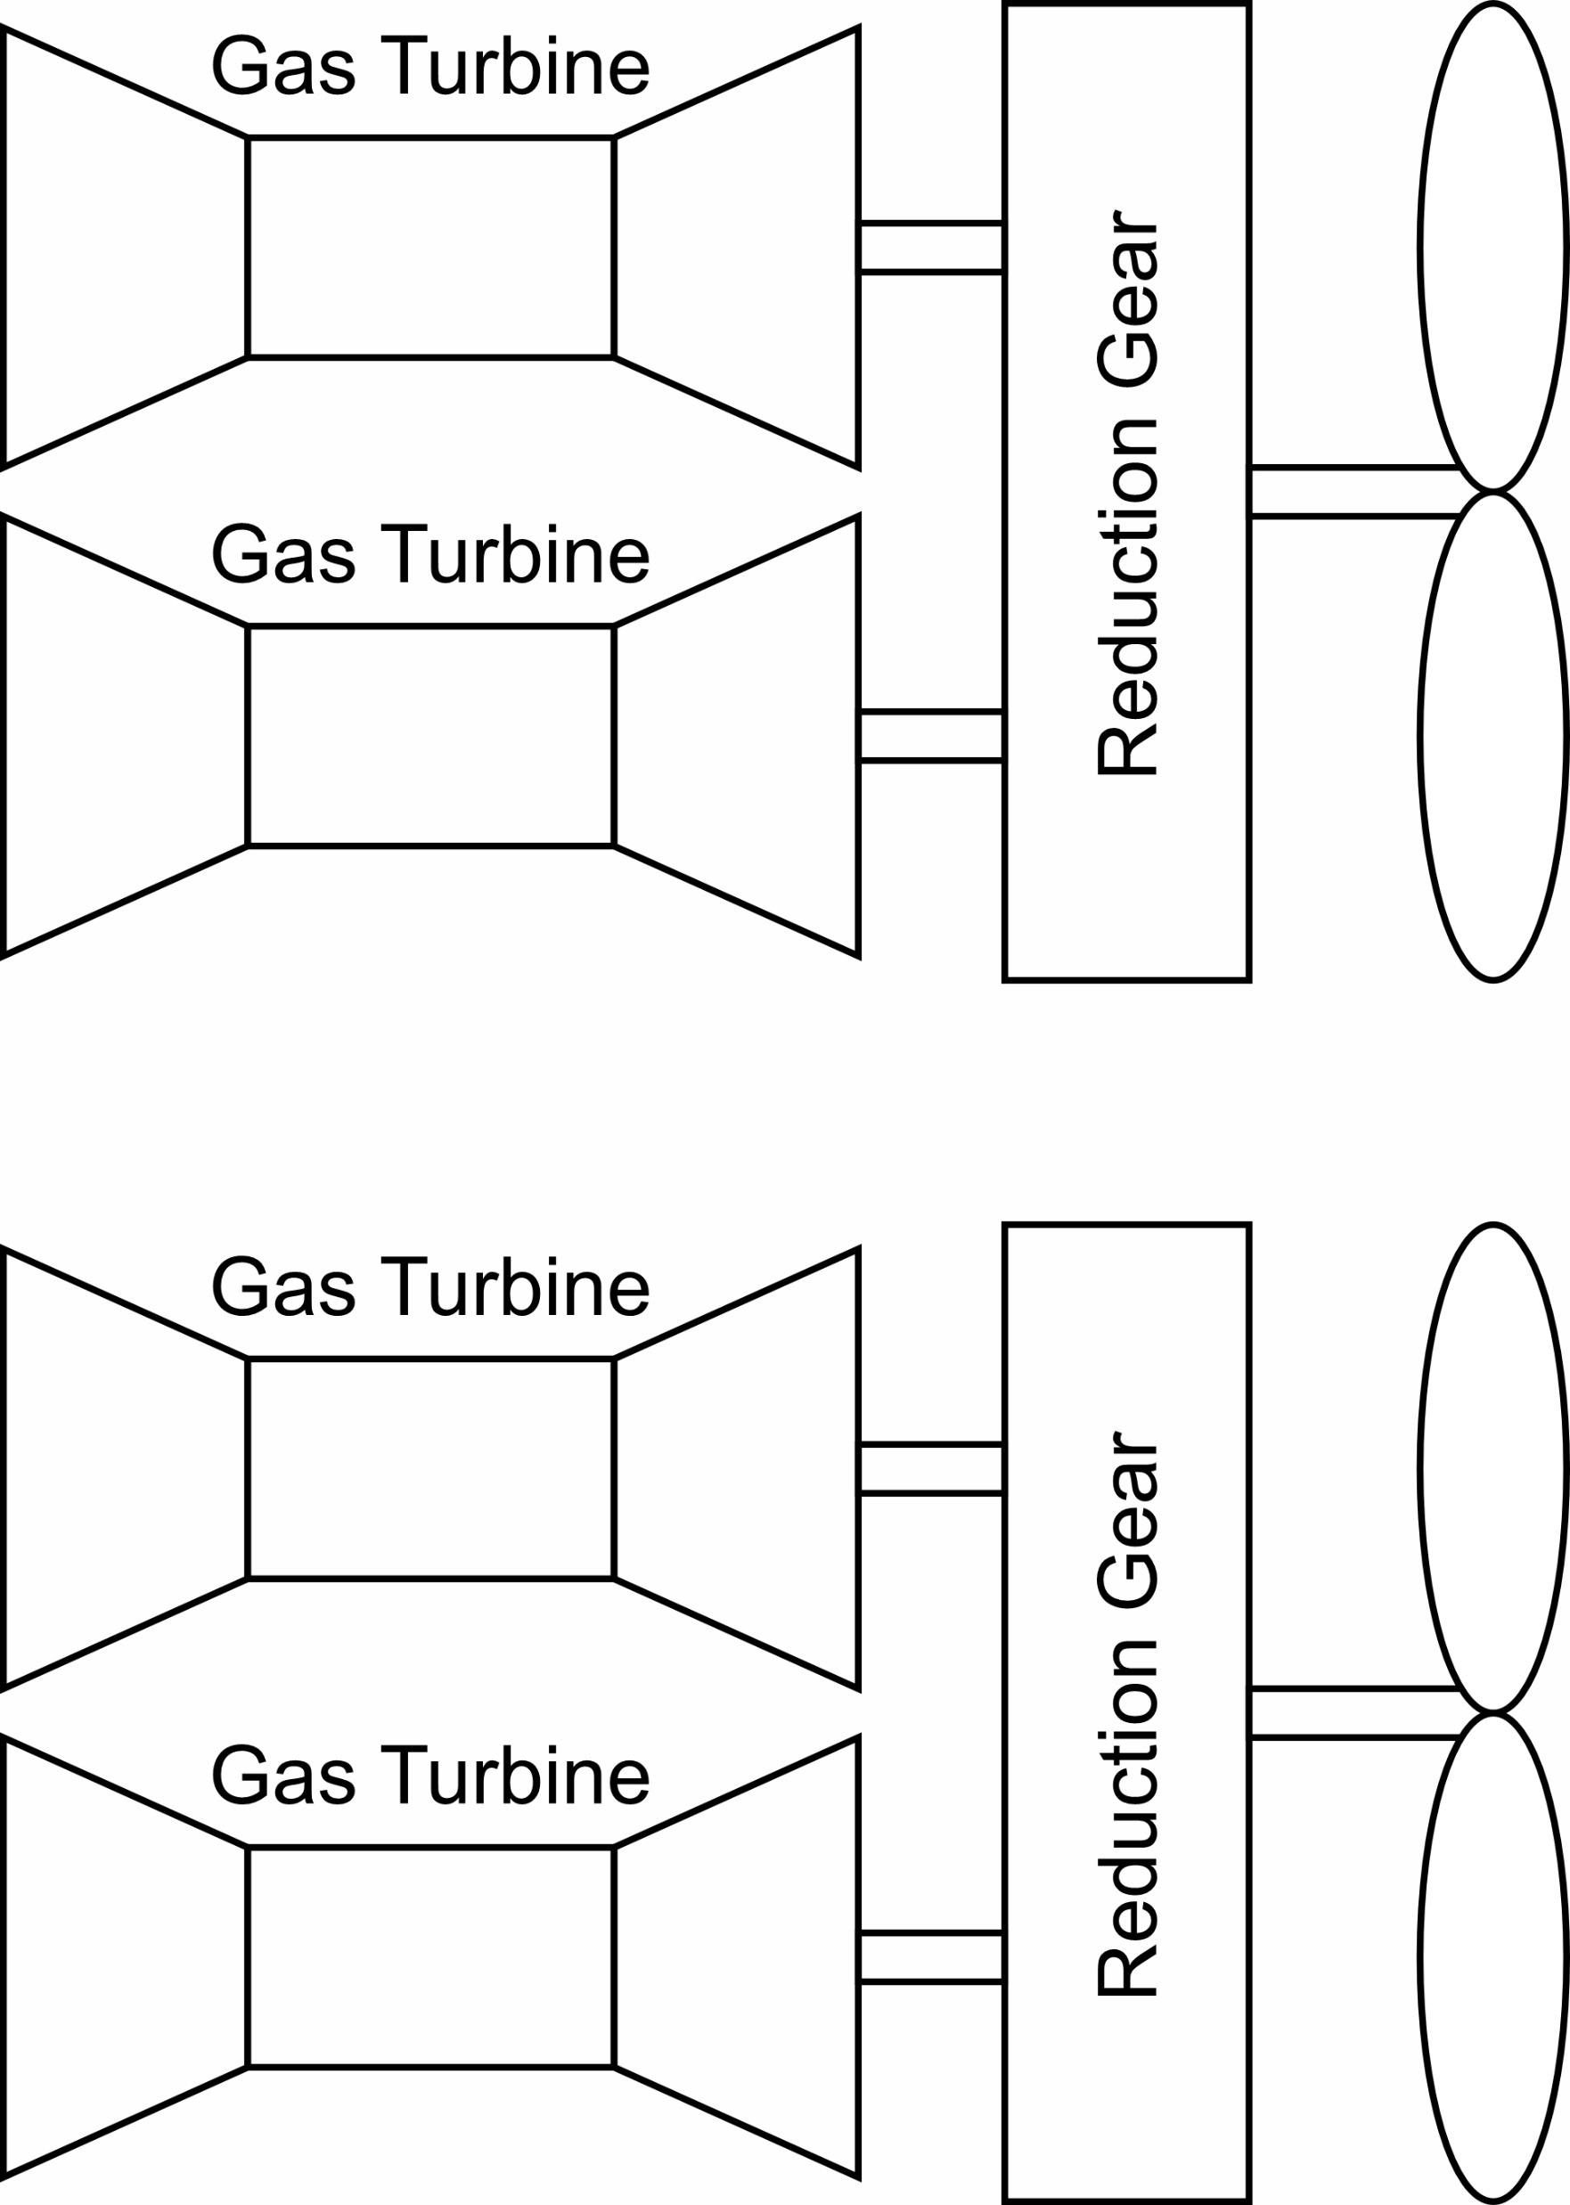
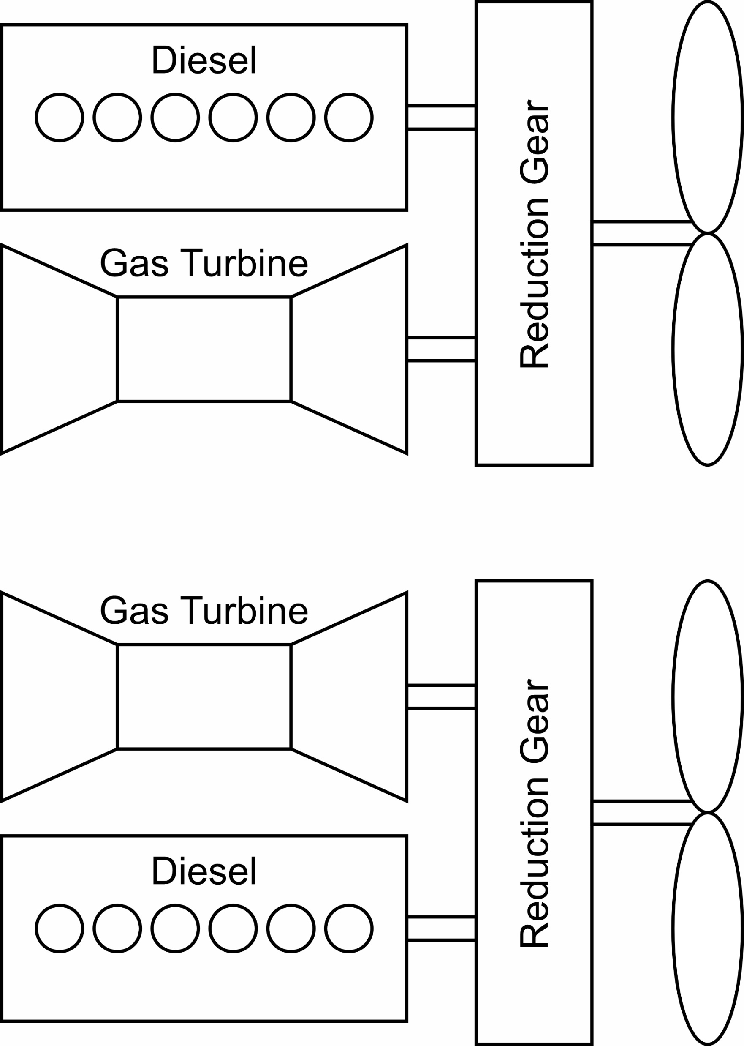
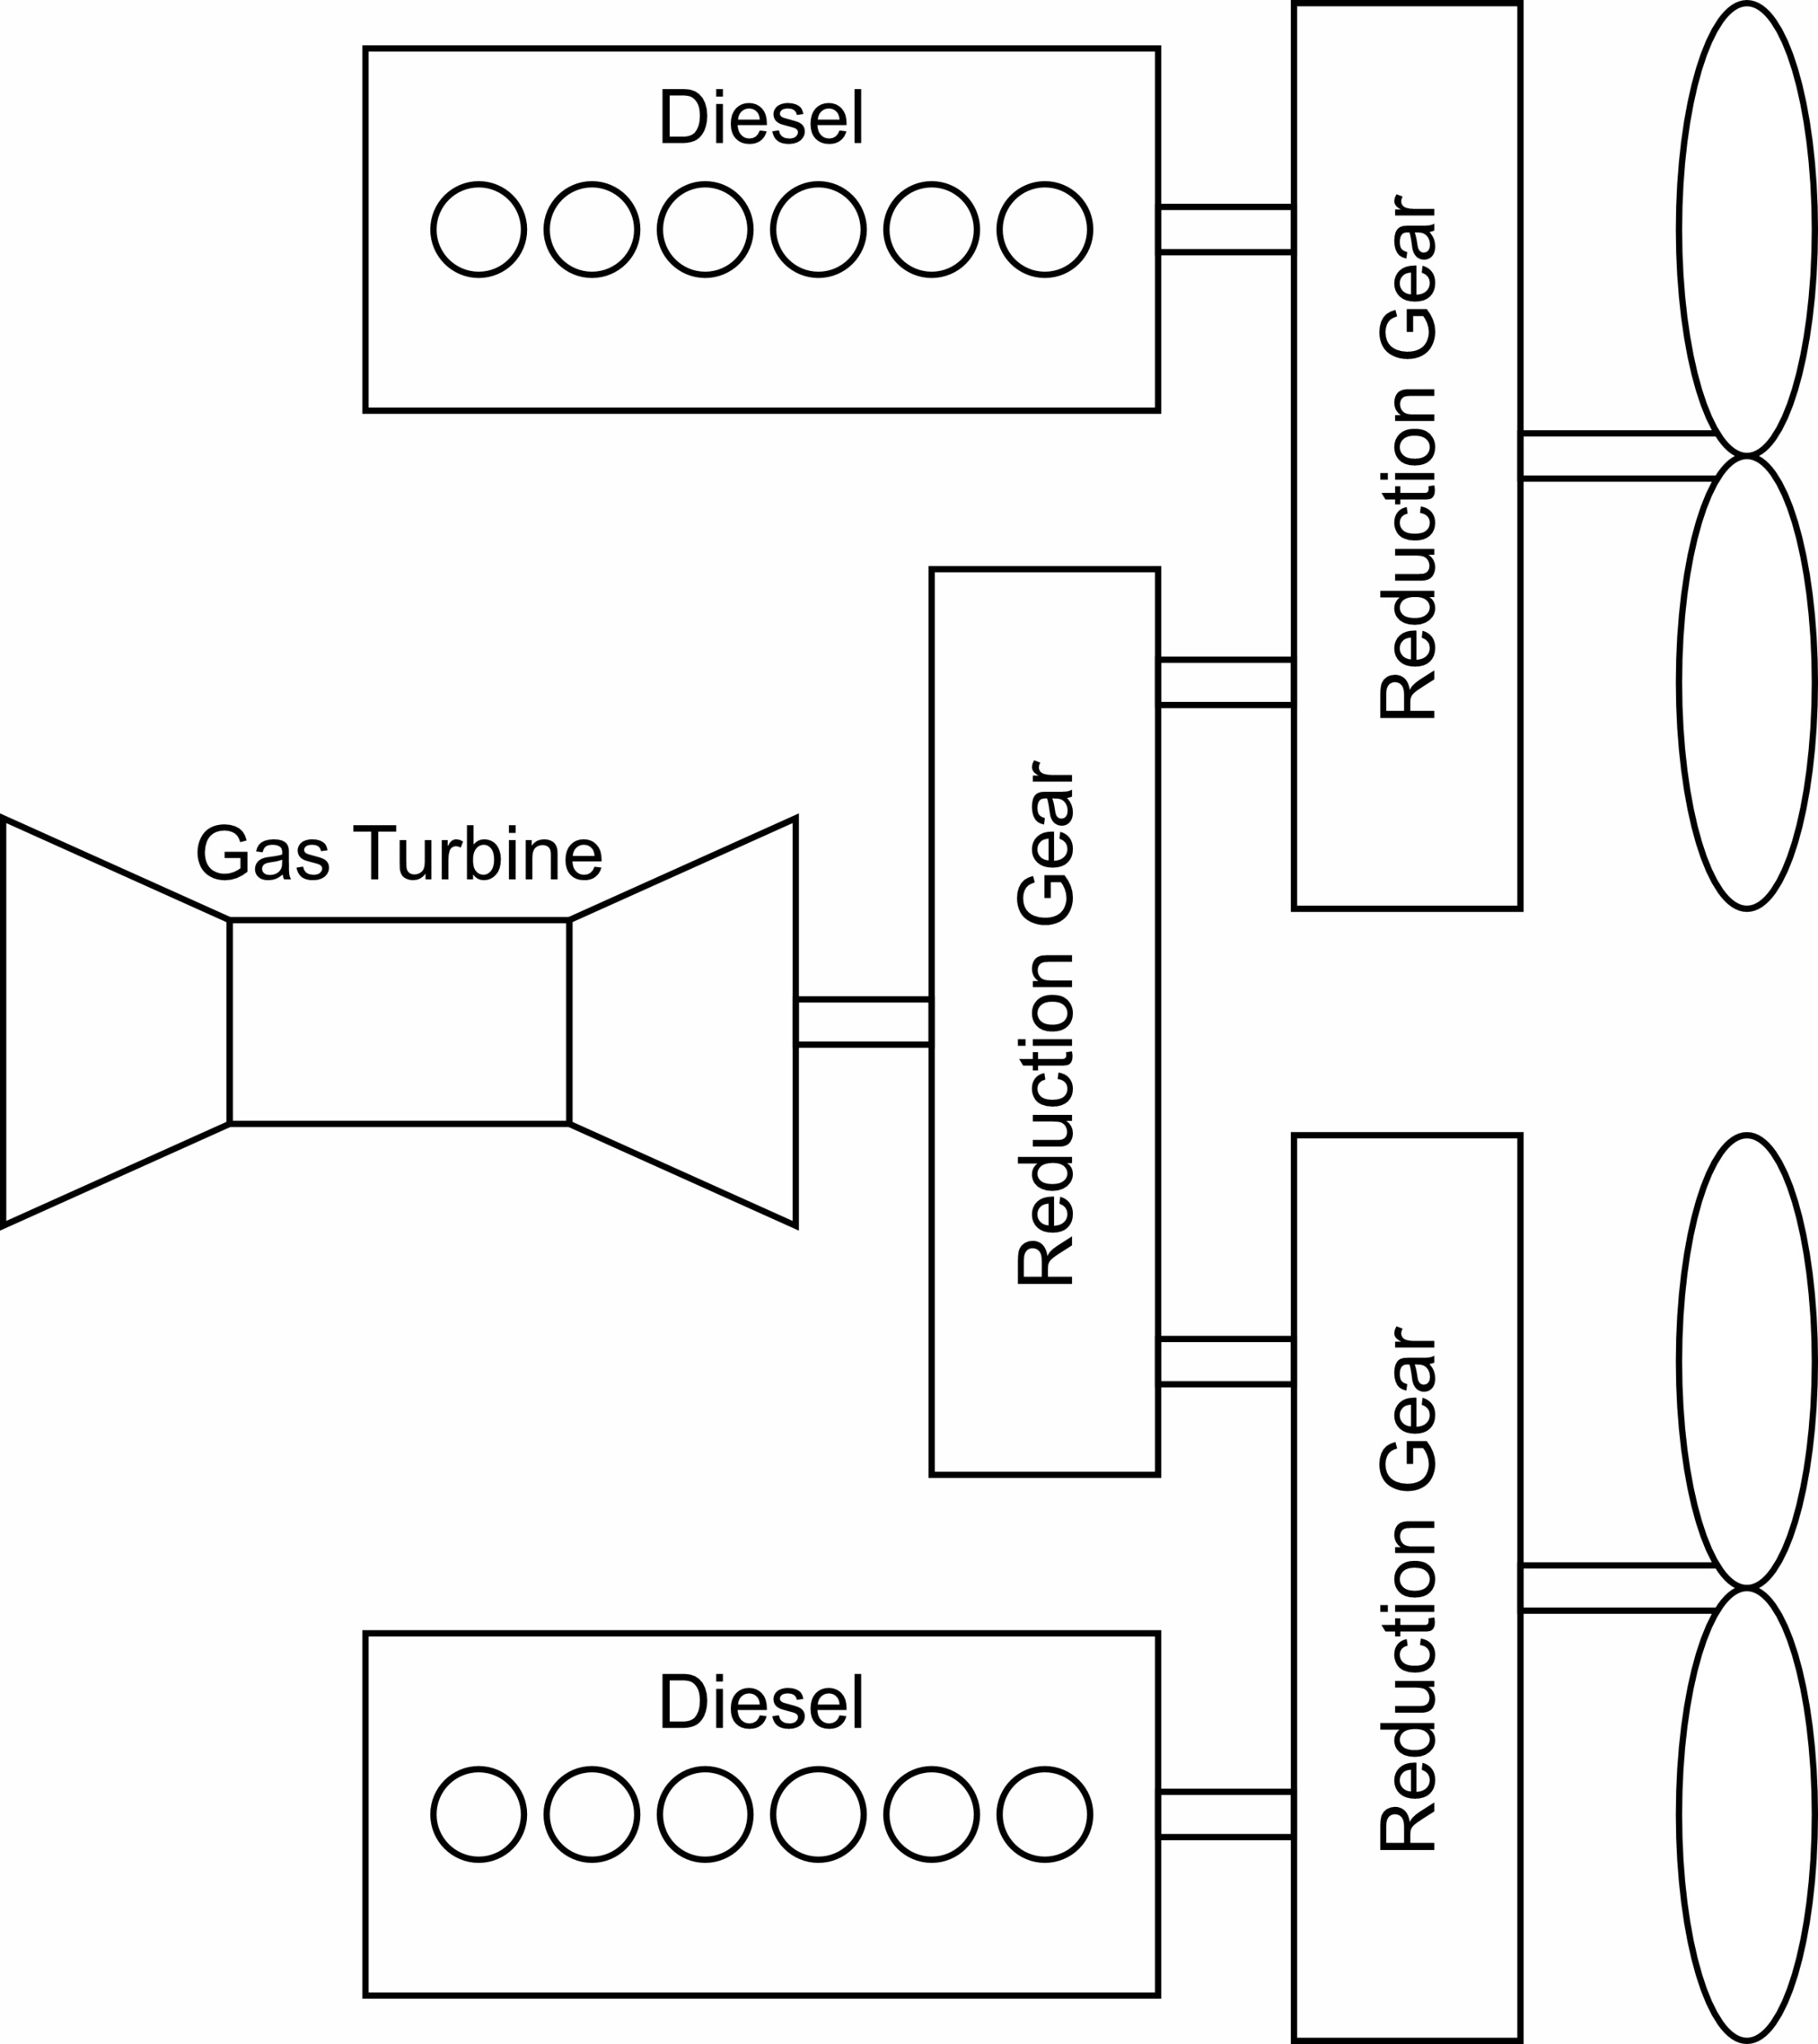
Mechanical drive ship propulsion
Prime movers
  Gas turbines
  Low speed diesel engines
  Medium speed diesel engines
  (Steam turbine)
Combinations of prime movers
  CODAG – Combined Diesel And Gas Turbine
  CODOG – Combined Diesel Or Gas Turbine

Slide 12
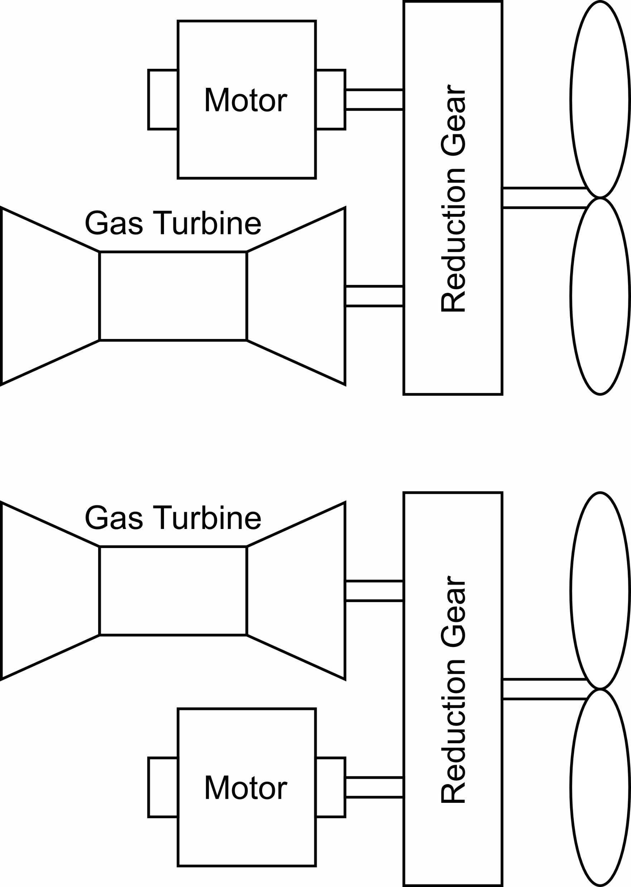
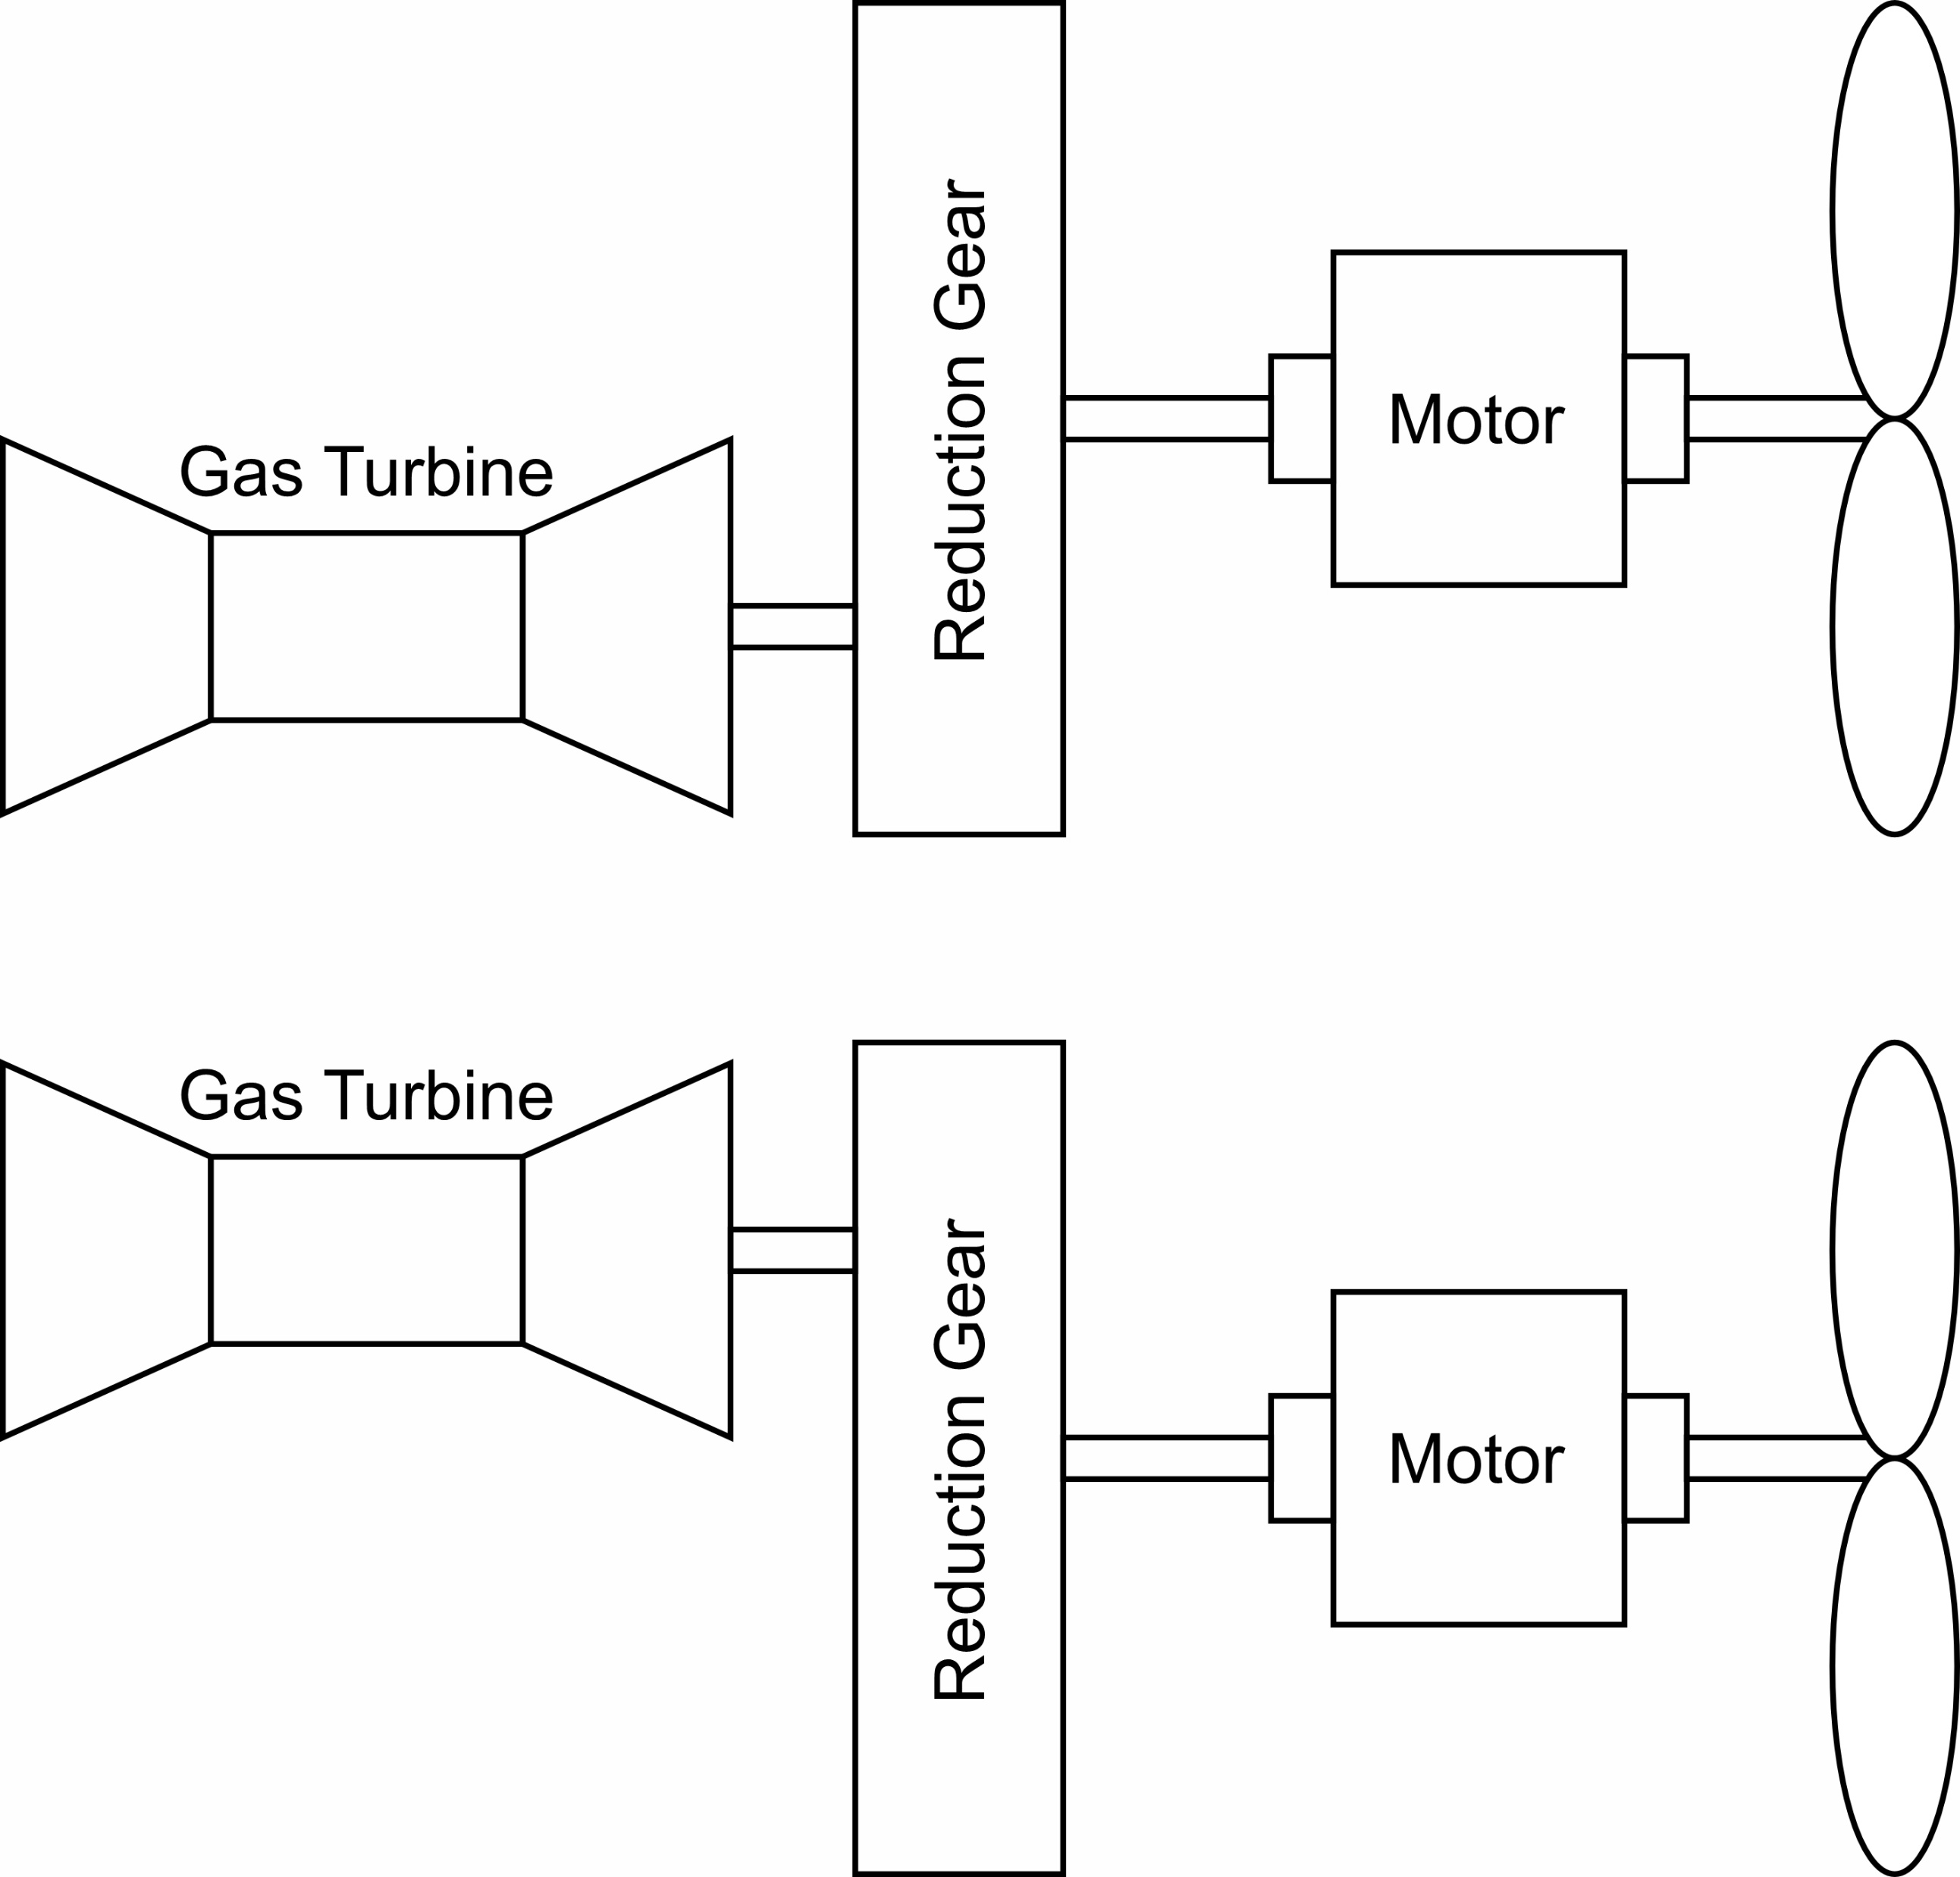
Hybrid electric drive ship propulsion
Combine electric motor with prime mover
Combinations
  CODLOG - Combined Diesel Electric Or Gas Turbine
  CODLAG – Combined Diesel Electric And Gas Turbine
  CODLOD – Combined Diesel Electric Or Diesel
  CODLAD – Combined Diesel Electric And Diesel

Slide 13
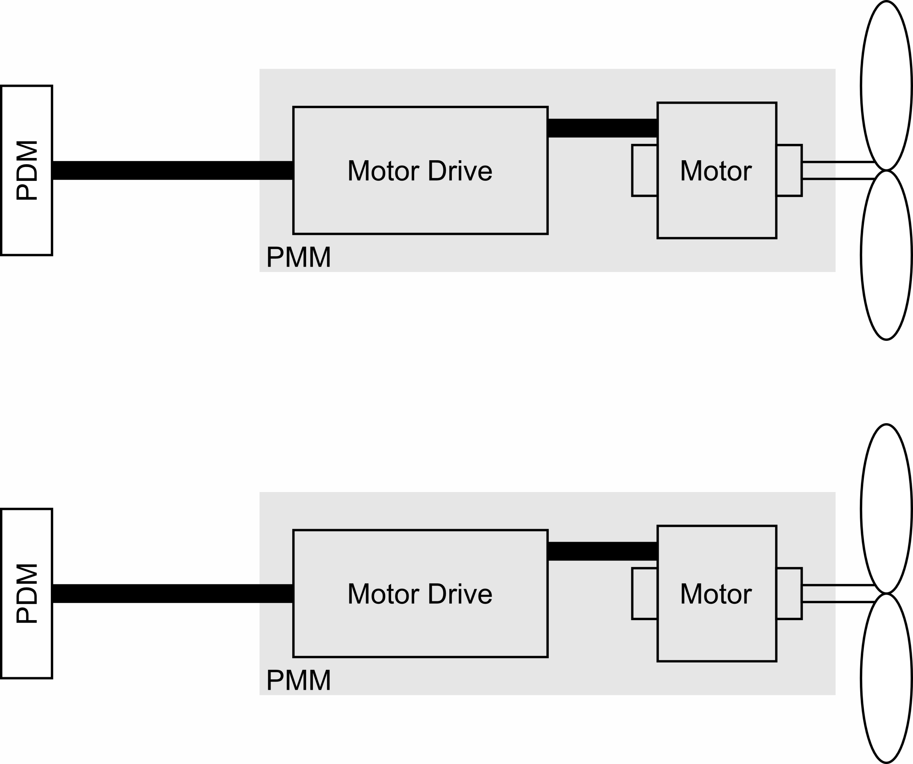
Integrated power system
All prime movers used to generate electrical power (Generator sets)
Generator sets power both ship service (PLM) and Propulsion Motors (PMM) at the same time.
Propulsion system starts with the electrical interface of the PMM to the PDM.

Slide 14
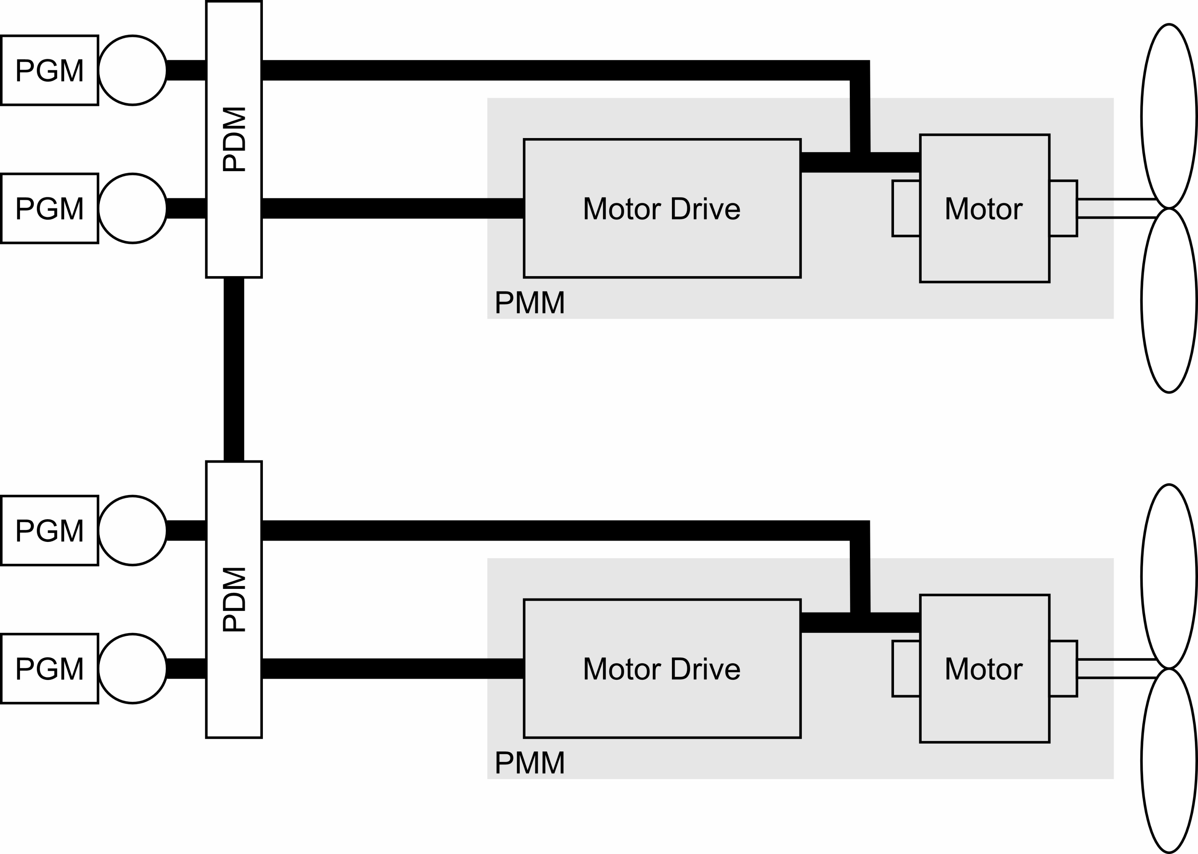
Electric Drive
Similar to Mechanical Drive except
  Reduction gear is replaced with:
    Propulsion generator
    Possibly a motor drive
    Propulsion motor
At high speeds, motors and generators operated synchronously
  Generator produces power with a frequency proportional to the shaft speed.
At low speeds:
  Use motor drive, or
  Operate motor drive and generator synchronously
    Possibly use controllable pitch propeller
Although once common, seldom used.
  Integrated Power Systems used instead.

Slide 15
A.C. vs D.C. power distribution
A.C. power generation and distribution is most common
  Most loads require low voltage a.c. power.
  Transformers provide reliable voltage conversion; enabling medium voltage a.c. power generation and distribution.
Low voltage d.c. power generation and distribution becoming more prevalent
  Enables more efficient operation of diesel generator sets.
  Easier integration of energy storage.
  Possible reduction in total power conversion steps.
Medium voltage d.c. power generation and distribution is technologically limited
  Largely due to limitations in fault protection equipment.

Slide 16
Low voltage vs medium (high) voltage distribution systems
Generating and distribution low voltage generally preferred if total electrical load is low (below several MW).
  Minimize voltage conversion steps
At higher power levels, fault protection equipment (such as circuit breakers) are not available for low voltages.
  Alternative is generation and primary distribution at medium voltage.
Fault protection for medium voltage d.c. systems not commercially available.
  Laboratory medium voltage d.c. circuit breakers have been successfully tested.
  Medium voltage d.c. circuit breakers are anticipated to eventually be commercially available.
Most loads still require low voltage (typically a.c.) power.
  Provided with transformers from a.c. medium voltage distribution.
  Provided with power converters from d.c. medium voltage distribution.

